Slide 1

Progression School Hackathon 1.0
Indrakumar singh atom

Slide 2

01
Use Case
Overview
02
Architecture
High level flow
03
Tech Stack
Key components
04
Product Demo
Walk thru of the Agentic AI app & its key features
This Photo by Unknown Author is licensed under CC BY-SA

Slide 3
Use Case | Financial Analyst Agent
Overview:
The Financial Analyst Agent is an AI-powered assistant designed to automate and streamline the process of financial research and analysis for companies.
Key Objectives:
Automate Financial Research: Reduce manual effort in collecting and analyzing financial statements and market data.
Leverage AI Agents: Use specialized agents for market research and financial strategy, each with distinct roles and expertise.
Provide Actionable Insights: Deliver comprehensive financial analysis and strategic recommendations for any company.

Slide 4

Architecture
Streamlit UI
Serper API
OpenAI LLM
Streamlit UI
Market Research
Agent
Financial Analyst
Agent
Final Output
User Query
CrewAi

Slide 5
Tech Stack
Frontend:
Streamlit
Agentic AI Logic:
CrewAI (for multi-agent team collaboration)
LLM APIs:
OpenAI
Any extra libraries:
Serper API (for web search)

Slide 6
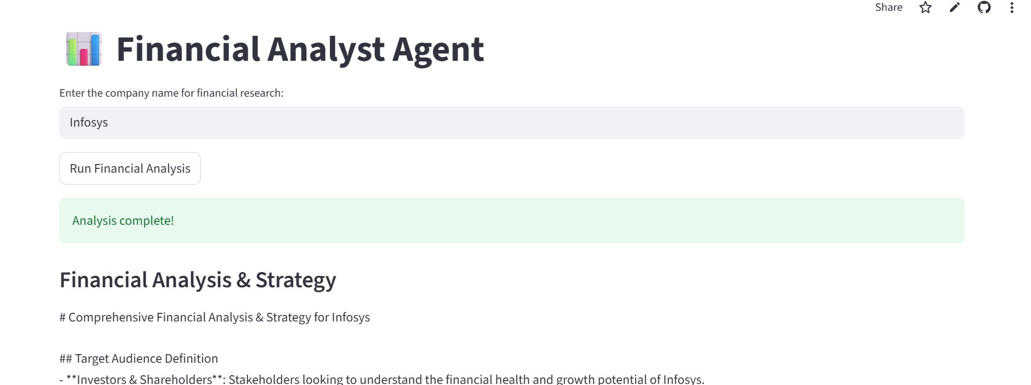
Product Demo app url: https://ps-hackathon-uahhfzsgeemphrzhfpdrq2.streamlit.app/

